Slide 1


Teaching Intro and Advanced Graphics with WebGL
Patrick Cozzi
Analytical Graphics, Inc.
University of Pennsylvania
Ed Angel
University of New Mexico
Slides: https://t.co/xuy7V2Q06m

Slide 2
Contents
Why WebGL?
Ed’s Course
Patrick’s Course
Tools

Slide 3
What is WebGL?
WebGL 1.0 is a JavaScript API based on OpenGL ES 2.0
uses HTML5 canvas element
runs in all recent browsers
OpenGL ES 2.0 is
shader based with no legacy fixed-function stages

Slide 4
Why WebGL and Why Teach with it?
Cross-platform broad deployment – web and mobile
Low barrier-to-entry
Fast iteration
Tools
Performance
Modern-ish API
Integrate with other web APIs
Notes:
Cross-platform broad deployment
Great motivation for students
Develop on Windows, Linux, or Mac
On all major browsers. Now in IE 11 and on by default in Safari in OS X Yosemite (this summer).
On mobile. Great support in Chrome on Android. Now in Safari on iOS 8 beta.
Low barrier-to-entry
Less code to create a first triangle than OpenGL + utility libraries.
Dev environment can be as simple as a text editor and browser. Many apps will require a simple webserver, e.g., for reading local textures. There are also online editors (later in this talk).
Fast Iteration
Just save and reload.
Tools
Browsers have great debuggers and profilers built-in.
There are several tools for WebGL debugging, profiling, and shader editing.
Performance
JavaScript performance is much better these days but still not nearly as fast as C++, however our graphics code runs on the GPU regardless of if it is WebGL or OpenGL so this is a useful point when teaching about how GPUs work.
Modern-ish API
WebGL is based on OpenGL ES 2.0, which is completely shader based. This is enough for teaching and intro course and even many advanced topics. WebGL 2 is based on ES 3.0 and will have many more modern features like instancing and uniform buffers. Many features are already available as extensions.
Integrate with other web APIs
Other HTML5 APIs (audio, joystick, geolocation, etc.) and web services.
Related: “Why use WebGL for Graphics Research?” by Patrick Cozzi. 2014. http://www.realtimerendering.com/blog/why-use-webgl-for-graphics-research/

Slide 5
Why not WebGL?
Students need to learn JavaScript: not an issue
Academic integrity? not an issue
Initial startup time for first application higher: minor issue
Notes:
Students need to learn JavaScript
Web and JavaScript development require some ramp up. A graphics course is also good for getting C/C++ experience so using JavaScript means less C/C++.
Seniors and grad students pick up JS much faster than their instructors (at least Ed)
Bias against JS in academic departments is far less than it used to be
Improvements in JS and JS engines have reduced the differences between using compiled vs interpreted code
Academic integrity? Not an issue
When deployed on the web, it is easy to view source. In Patrick’s course at Penn, we make each student’s project different, e.g., implement a ray tracer and select 3 of 5 effects. This also excites students and they often take the project further.
In Ed’s course, even though the first three assignments were the same for all students, there was no collaboration outside of what is allowable. Since the students were all seniors and graduate students, they all understand and accept the academic integrity guidelines.
In Ed’s course, there was a little more time spent at the beginning to cover some JS and HTML that was more than compensated for with the lack of having to worry about platform dependencies and GLUT/GLEW/freeglut.
In Patrick’s course at Penn, we use WebGL whenever possible. We use OpenGL only when we need access to recent GPU features like compute and tessellation shaders.

Slide 6
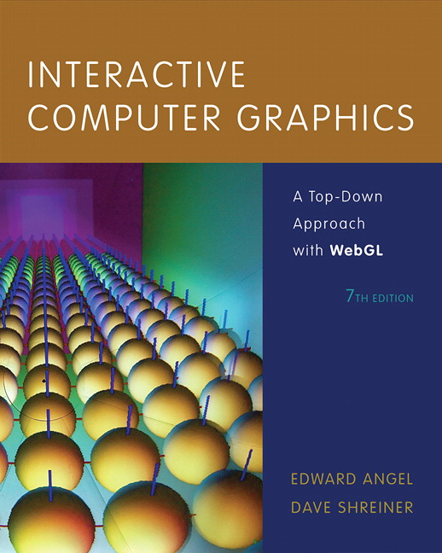
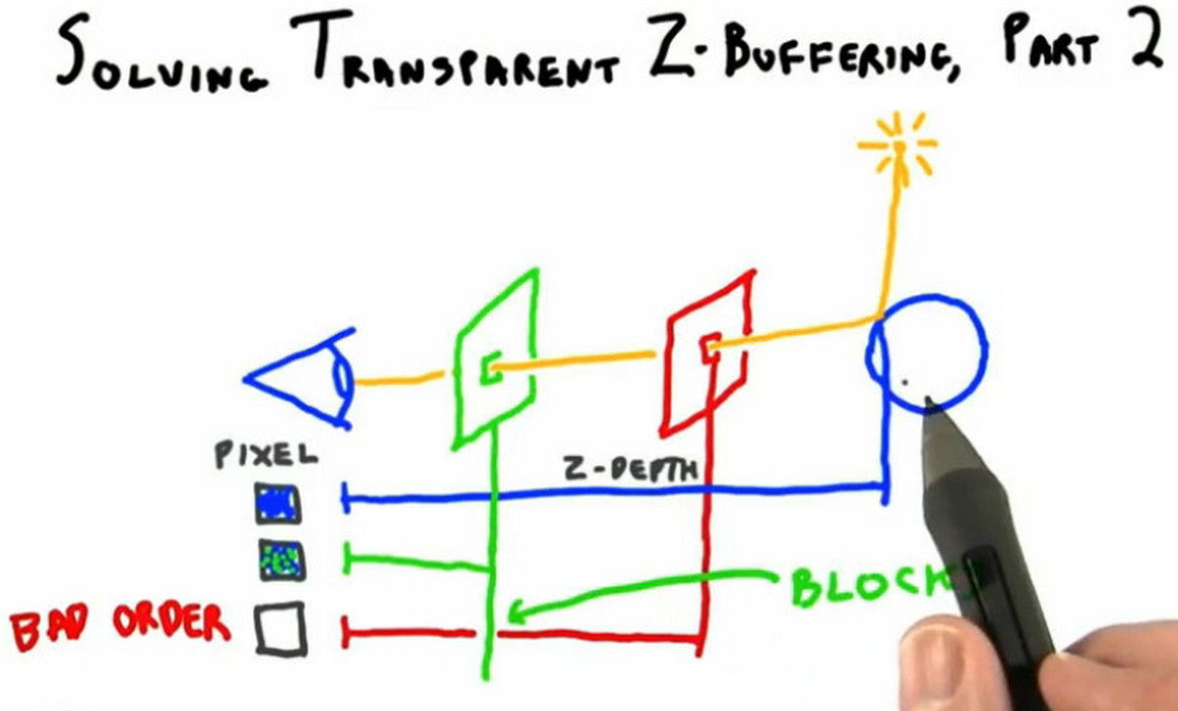
WebGL in Teaching
Interactive 3D Graphics Udacity course by Eric Haines
Intro class now in WebGL
Notes:
Interactive Computer Graphics with WebGL
Now in its 7th edition moved from core-profile OpenGL to WebGL.
There are also many other graphics book on WebGL like the “WebGL Programming Guide” by Kouichi Matsuda and Rodger Lea and “WebGL Beginner’s Guide” by Diego Cantor and Brandon Jones (example code: http://voxelent.com/resources/books-code-examples/).
Interactive 3D Graphics
By Eric Haines
Udacity course: https://www.udacity.com/course/cs291
~52K students
Penn guest lecture on teaching the course, “Computer Graphics in a MOOC: Beyond the Hype and Hysteria” - http://cis565-fall-2013.github.io/lectures/11-04-Computer-Graphics-in-a-MOOC-Beyond-the-Hype-and-Hysteria.pptx
More recent SIGGRAPH BOF on teaching the course, “Computer Graphics in a MOOC” - http://bit.ly/sigbof
Introduction to WebGL Programming
SIGGRAPH course moves from OpenGL to WebGL in 2014
Being recorded and will be on YouTube as part of SIGGRAPH University
OpenGL course now online: https://www.youtube.com/watch?v=6-9XFm7XAT8
SIGGRAPH 2012 also had “Graphics Programming for the Web” course (slides: http://www.khronos.org/webgl/wiki/Presentations#SIGGRAPH_2012_Course_.22Graphics_Programming_for_the_Web.22)

Slide 7
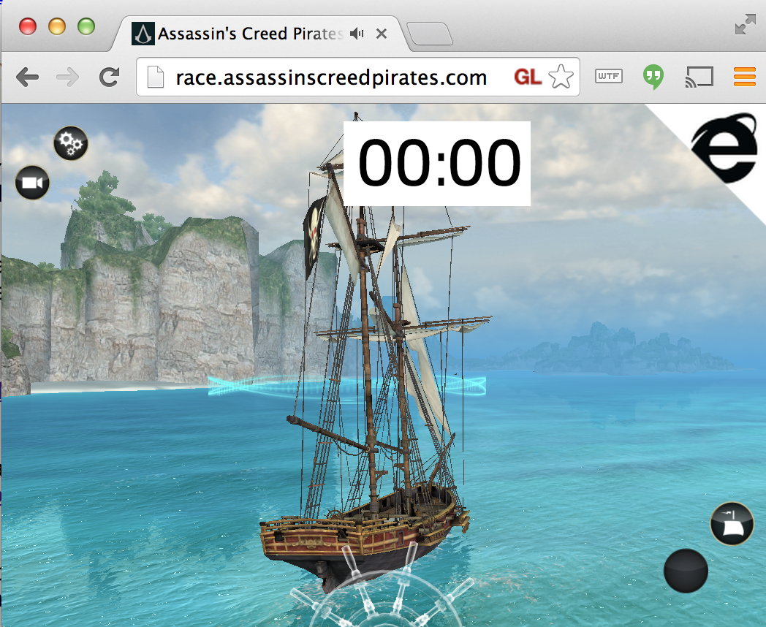
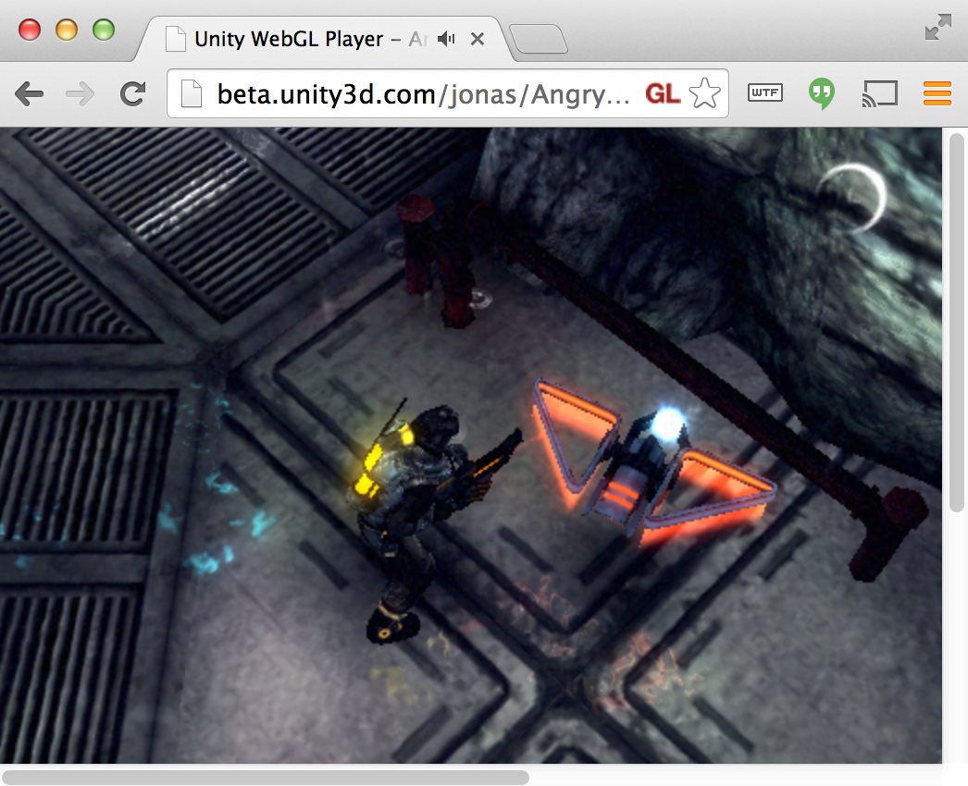
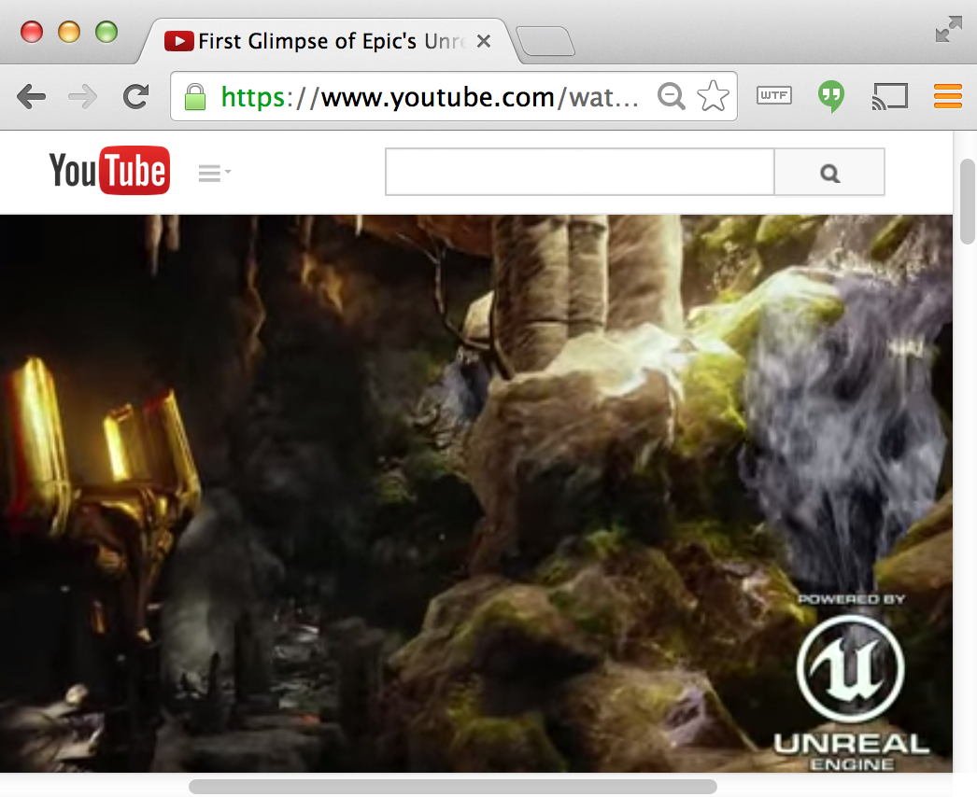
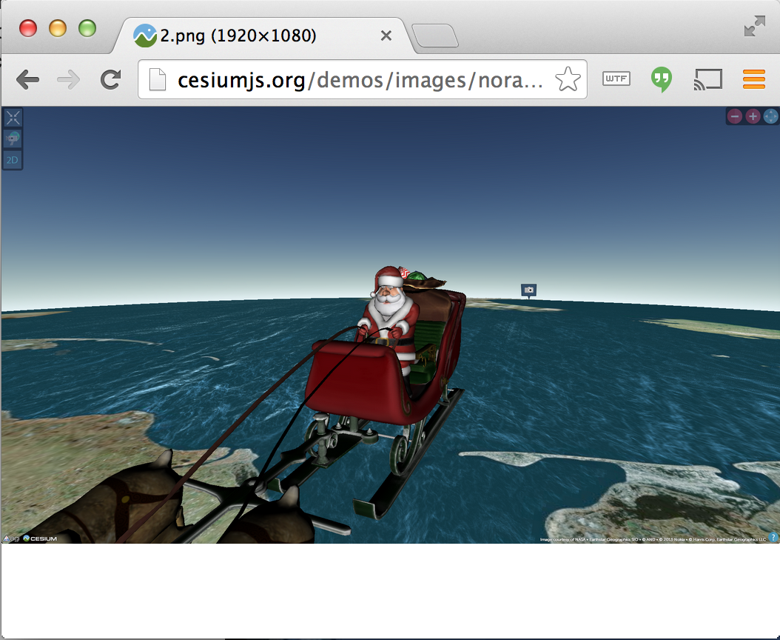
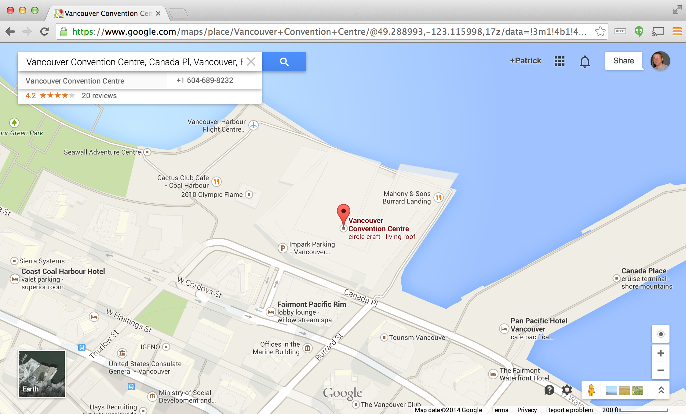
High-Profile WebGL Uses
Notes:
Assassin’s Creed – Microsoft + Ubisoft
IE 11 desktop and mobile
JavaScript using Babylon.JS
http://modern.ie/en-us/demos/assassinscreedpirates
Unity - Unity + Mozilla
Unity runtime. C/C++ -> emscripten -> JavaScript + asm.js
Game code. C# -> .NET bytecode -> C++ -> emscripten -> JavaScript + asm.js
http://blogs.unity3d.com/2014/04/29/on-the-future-of-web-publishing-in-unity/
http://blogs.unity3d.com/2014/05/20/the-future-of-scripting-in-unity/
Unreal Engine 4 – Epic + Mozilla
C++ -> emscripten -> JavaScript + asm.js
http://techcrunch.com/2014/03/12/epic-partners-with-mozilla-to-port-unreal-engine-4-to-the-web/
NORAD Tracks Santa - Analytical Graphics, Inc. + partners
JavaScript using Cesium
In 2013, 48.8% WebGL success across all browsers & platforms for 20M visitors, an increase of 146% over 2012.
http://cesiumjs.org/demos/noradtrackssanta.html
Google Maps – Google
Rewritten using WebGL
Vector data is no longer rasterizered, smooth zooms, 3D in beta
“Google Maps + WebGL = MapsGL” by Bill Baxter. 2012. https://docs.google.com/presentation/d/1pL-OZnsWIKWcXflfJV8MPH3kKBehn0Mlx6-cdjmP3A0/edit#slide=id.g1e3a90e_1_28
“Google MapsGL” by Bill Baxter and James Darpinian. 2012. https://docs.google.com/presentation/d/1zZgkOcQmpq2vHy9B6_2tF49ILKeasLqXrsrCn-Ni_vY/edit
“Earth in Google maps: rendering trillions of triangles in JavaScript” by Janne Kontkanen and Evan Parker. 2014. http://dl.acm.org/citation.cfm?id=2614194
More high-profile uses of WebGL
Sony built PS4 UI on WebGL - http://tonyparisi.wordpress.com/2014/01/14/the-tipping-point/
Disney - Find Your Way to OZ movie promo - http://www.findyourwaytooz.com/
Warner Brothers – Gravity movie promo - http://gravitymovie.warnerbros.com/#/home
New York Times – Hang glider visualization - http://www.nytimes.com/interactive/2013/01/13/sports/hang-gliding-record.html?_r=0
iOS RAGE WebGL demo (by Brandon Jones, not id)
https://www.youtube.com/watch?v=d0S2dsuSxHw
http://blog.tojicode.com/2011/05/rage-webgl-tech-talk.html
Quake 4 assets (using Turbulenz, not by id)
http://www.geek.com/games/turbulenz-webgl-engine-proves-quake-4-is-possible-in-a-browser-1505401/

Slide 8
Two Approaches
WebGL from the beginning
OpenGL then WebGL
fixed function OpenGL or shader-based OpenGL
Both approaches share some key elements that must be presented

Slide 9
Necessary New Elements
JavaScript
HTML
Execution in a browser
Interactivity

Slide 10
Starting with WebGL Ed’s course
Notes:
All student projects: http://www.cs.unm.edu/~angel/SIGGRAPH14/projects.html

Slide 11
Student projects from
CS 495/595 ECE 491/591: Special Topics (online)
CS/ECE 412: Computer Graphics

Slide 12
Syllabus
Week 1: Introduction and Overview
Week 2: Introduction to WebGL
Week 3: GLSL and Shaders
Week 4: Input and Interaction
Week 5: Geometry and Transformations
Week 6: Modeling and Viewing
Week 7: Projection Matrices and Shadows
Week 8: Lighting and Shading
Week 9: Buffers and Texture Mapping
Week 10: Discrete Techniques
Week 11: Off-Screen Rendering.
Week 12: Hierarchy
Week 13: Implementation
Week 14: Curves and Surfaces
Week 15: Global Rendering
Notes:
This syllabus is almost identical to the syllabus that used desktop WebGL. Perhaps the biggest difference is that there is more time to discuss input and interaction that with the previous version.

Slide 13
Basic Decisions
Only JS and HTML
no CSS or JQuery for required projects
discourage use of three.js
shaders in HTML file
Encourage use of separate HTML and JS files
HTML file for page layout, resources and shaders
JS file for WebGL
Notes:
Minor issue arises if you use separate text files for the shaders. Unless you run from a server, some browsers including Chrome see this as a cross origin request and will not read the files as it is a security issue. In practice students simply switched browsers or used a server.
Although the interactive widgets such as buttons and sliders are not pretty using the defaults with just JS and HTML, you can add each with a couple of lines of code.
Although three.js (see Eric Haines’ Udacity course) is very powerful and contains some tremendous sophistication, it is a scene graph API so avoids much of what we want to teach in a computer graphics course, either an introductory one or one that stresses advanced rendering or real-time graphics.

Slide 14

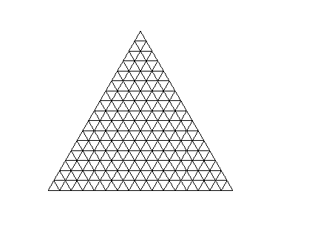


Project 1: Tessellation and Twist
triangle
tessellated triangle
twist without tessellation
twist after tessellation
Notes:
Figures are from my assignment page.
I introduced recursive subdivision to generate the tessellated triangle. Subdivision was used in a number of other places in the course such as for generating fractals and rendering curves and surfaces.

Slide 15
Project 2: CAD
Stephen Harding
Notes:
At this point in the course, we had yet to cover lighting in detail so students had to be clever to render their objects so they looked three-dimensional. Some students added a database aspect so objects could be exported or recalled and reedited.

Slide 16
Project 3: 3D Maze
Notes:
Students had to first build a maze using a graph traversal strategy.
The required view was from inside of the maze and the user had to navigate through it without a view as above which was an optional add-on. Students were able to use lighting and/or texture mapping on the walls.
Demo by Luke Balaoro: http://www.cs.unm.edu/~lbalaor/WGL_Assignment_III/playable.html

Slide 17
Term Project: CSG Modeler
Zach Friendland
Notes:
Above shows a sphere minus a cylinder.
Demo: http://cs.unm.edu/~zach/cs591/project/project.html

Slide 18
Term Project: Animated Voronoi Diagram
Trevor Corriveau
Notes:
The calculations were all done in the fragment shader. Once a display was completed, the vertices moved randomly and diagram recomputed.
Other projects included:
An n x n interactive Rubik’s cube
Ray marching
Interactive games
Interactive function display programs that parsed expressions for functions and displayed them in 2 or 3D.
A couple of projects used three.js. These were not my favorites as the students had to spend a lot of their time learning another API and their projects seemed to have as much code as if they had just stuck with only WebGL.
Demo: http://cs.unm.edu/~tcorrive/WebGL%20Final%20Project/TCorriveau_FinalProject.html

Slide 19
Differences
At the beginning, we needed to spend a little time on the following none of which were prerequisites for the course
JavaScript
HTML5
Execution in a browsers

Slide 20
Results
At the end:
students did better with the WebGL version and liked it better
we were able to bring a lot more interactivity back into the course
experienced no platform-dependent problems

Slide 21

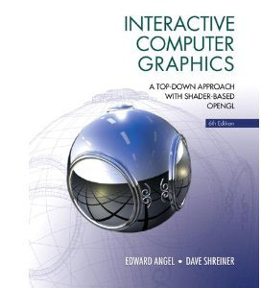

Slide 22
From OpenGL to WebGL
The course we just described replaces the course that was taught with desktop OpenGL
That course had transitioned from the fixed-function pipeline to the a fully shader-based OpenGL three years ago
Notes:
Also see:
“WebGL for OpenGL Developers” in OpenGL Insights by Patrick Cozzi and Scott Hunter. 2012. http://openglinsights.com/
“An Introduction to JavaScript for Sophisticated Programmers” by Morgan McGuire. 2014. http://casual-effects.blogspot.com/2014/01/an-introduction-to-javascript-for.html
“JavaScript: The Good Parts” by Douglas Crockford. 2008. http://shop.oreilly.com/product/9780596517748.do

Slide 23
Student projects from
CIS 565: GPU Programming and Architecture CIS 700/003: Real-Time Rendering
Notes:
All student work:
CIS 565
Fall 2013: http://cis565-fall-2013.github.io/studentwork.html
Fall 2012: http://cis565-fall-2012.github.io/studentwork.html
Spring 2012: http://cis565-spring-2012.github.io/studentwork.html
Spring 2011: http://www.seas.upenn.edu/~cis565/StudentWork-2011S.htm
CIS 700
Spring 2014: https://docs.google.com/presentation/d/1JbPvI1NS7ExcDAGiAbU6cjhfUQzfhptHNNa48eK97oo/edit#slide=id.p

Slide 24
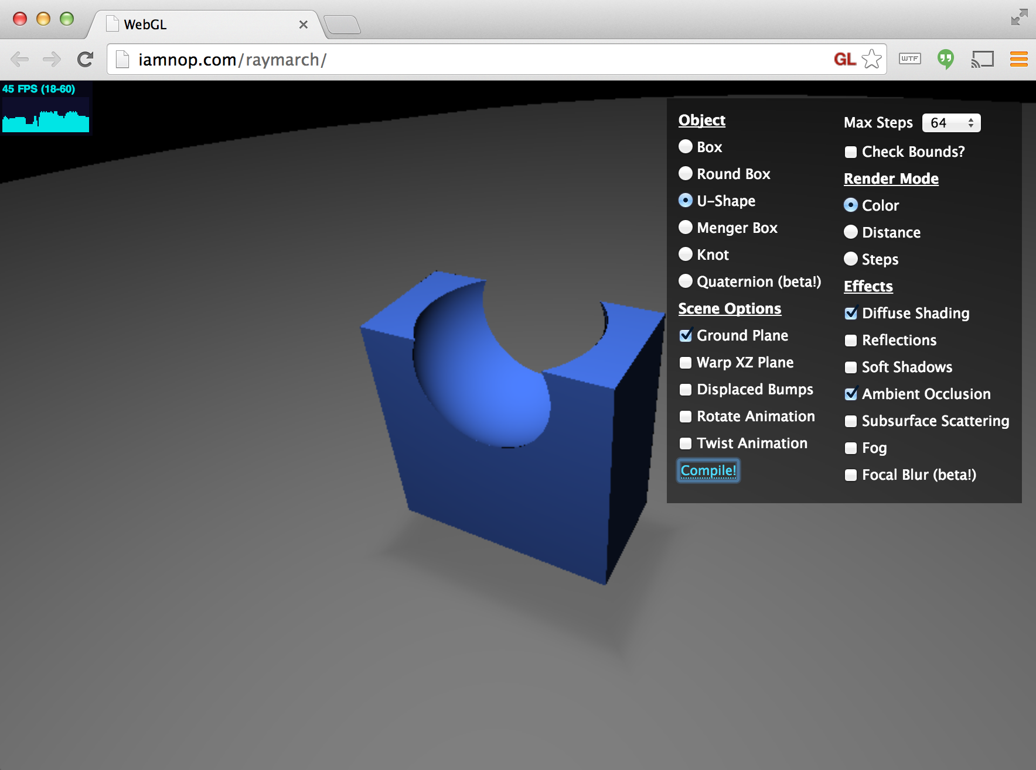
Ray Marching Distance Fields
Nop Jiarathanakul – CIS 565 Spring 2012
Notes:
Demo: http://iamnop.com/raymarch/
Blog: http://nopjia.blogspot.com/2012/04/final-deliverables.html

Slide 25
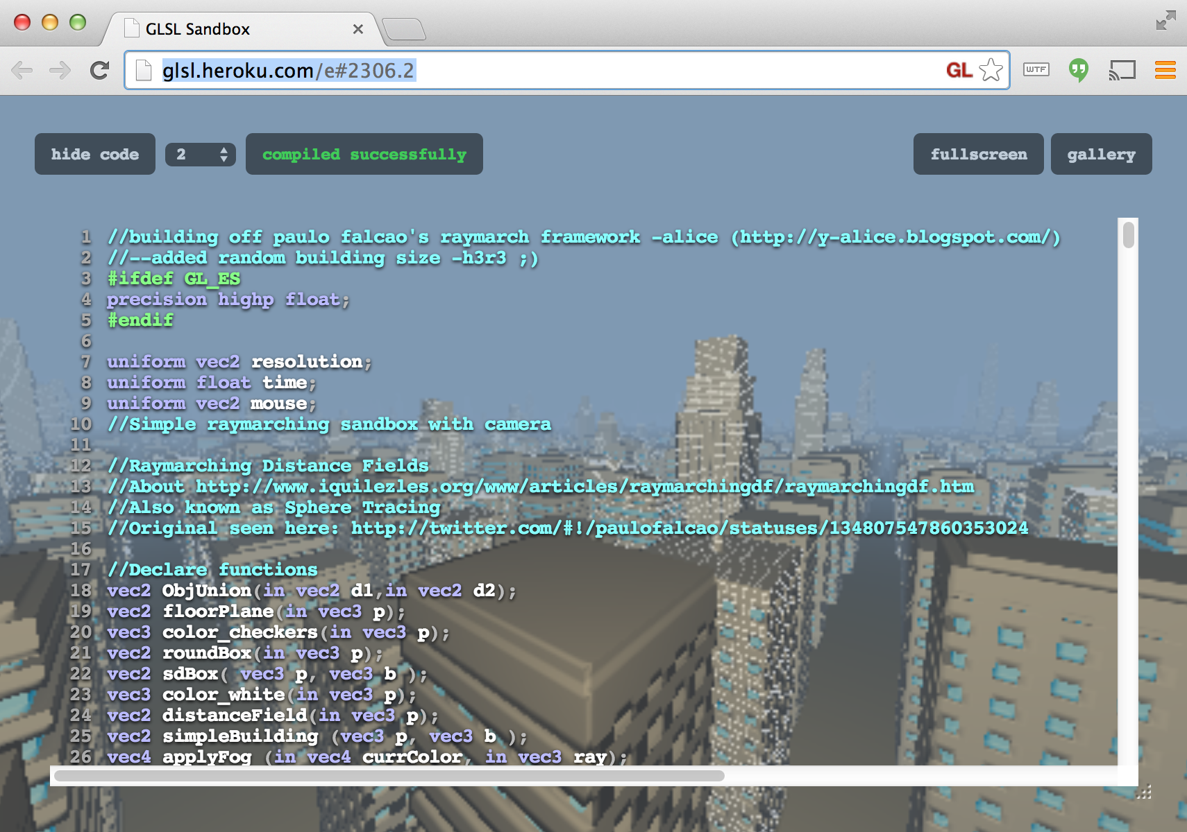
Procedural Infinite City
Alice Yang – CIS 565 Spring 2012
Notes:
Demo: http://glsl.heroku.com/e#2306.2
Blog: http://y-alice.blogspot.com/2012/04/final-submission.html

Slide 26
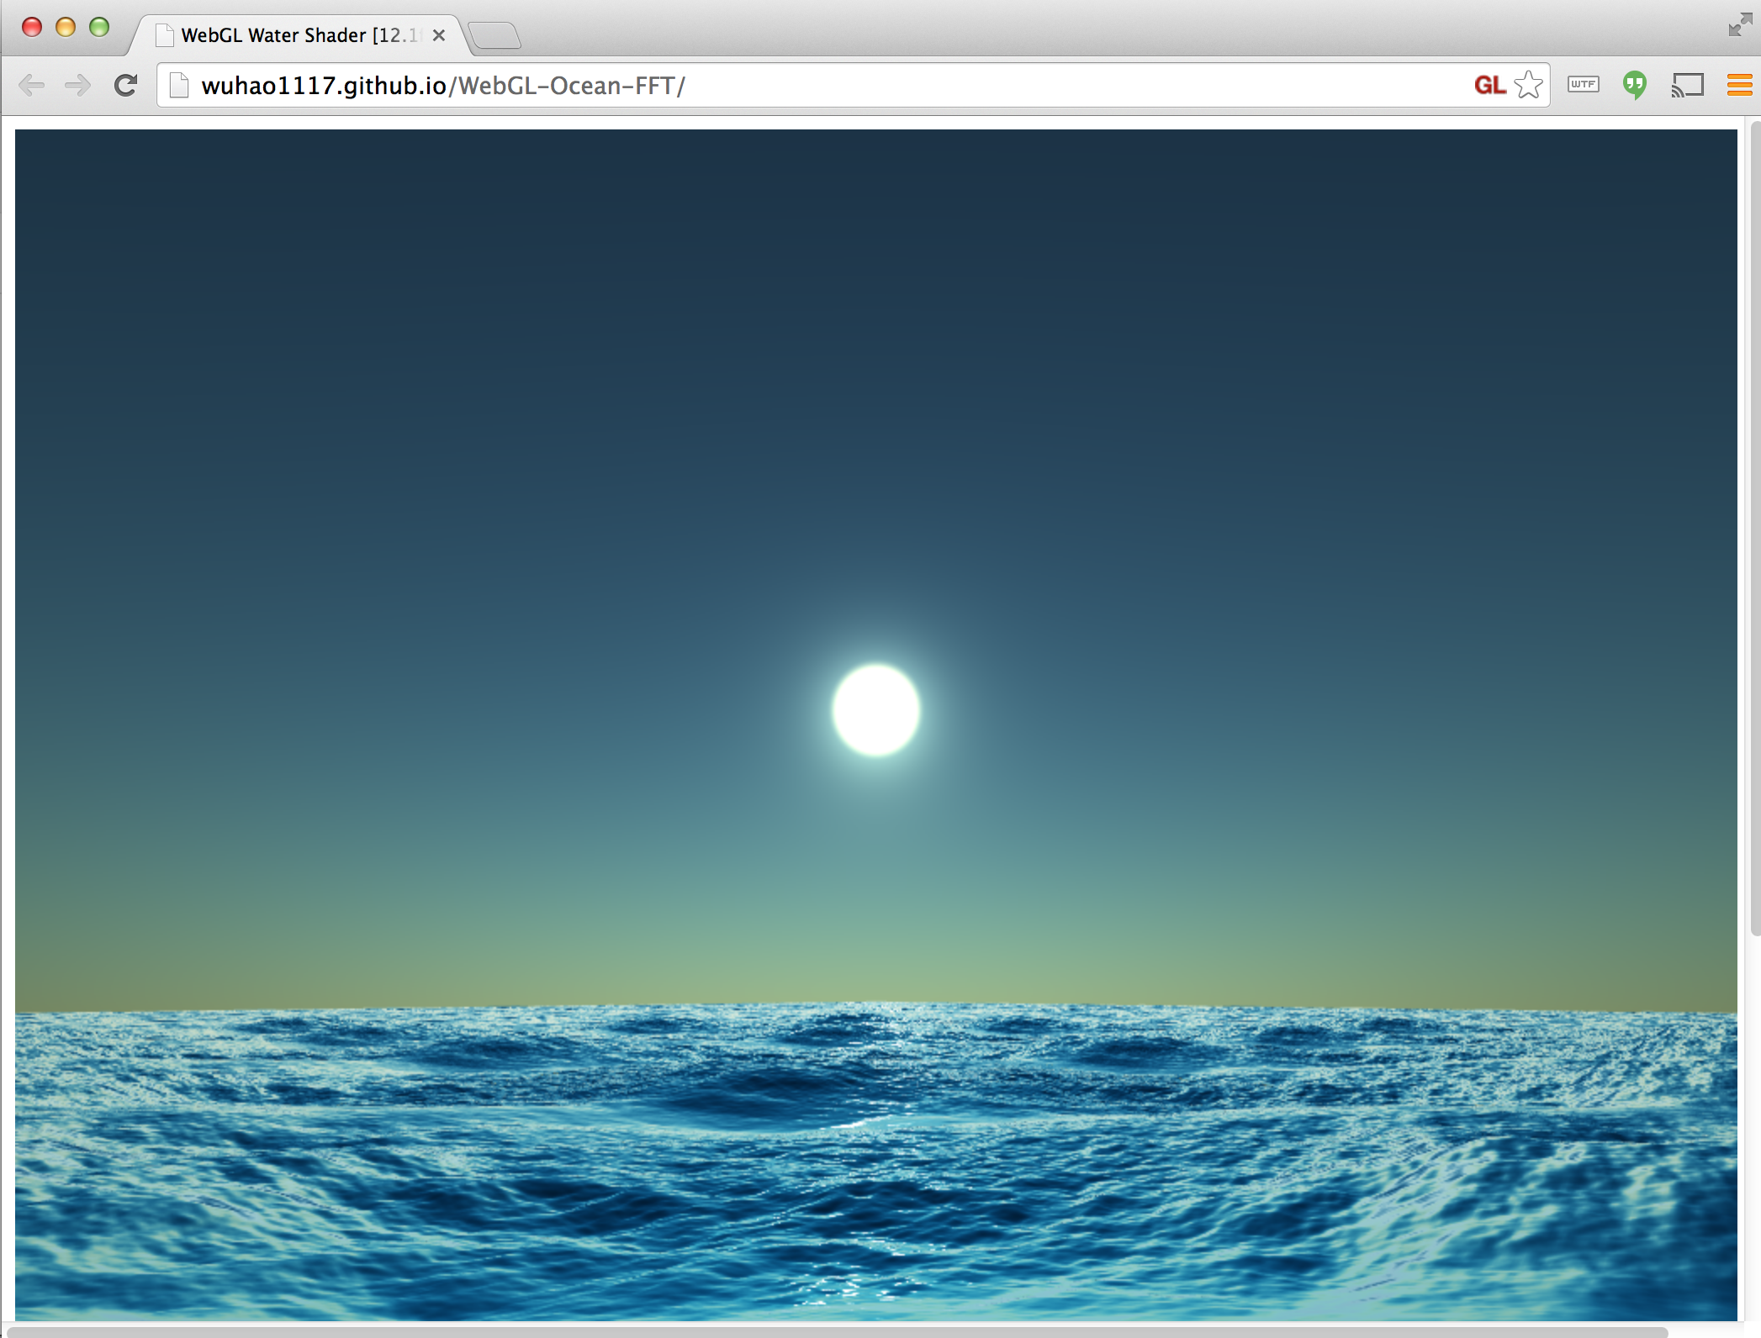
Water
Hao Wu and Guanyu He – CIS 565 Fall 2013
Notes:
Demo: http://wuhao1117.github.io/WebGL-Ocean-FFT/
Info: http://www.wuhao.co/webgl-fft-ocean.html

Slide 27
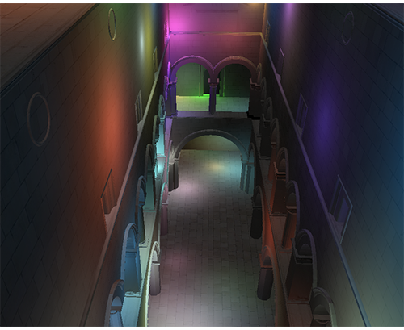
Deferred Shading
Sijie Tian and Yuqin Shao – CIS 565 Fall 2013
Notes:
Demo: http://sijietian.com/WebGL/deferredshading/index.html
Article: https://hacks.mozilla.org/2014/01/webgl-deferred-shading/

Slide 28
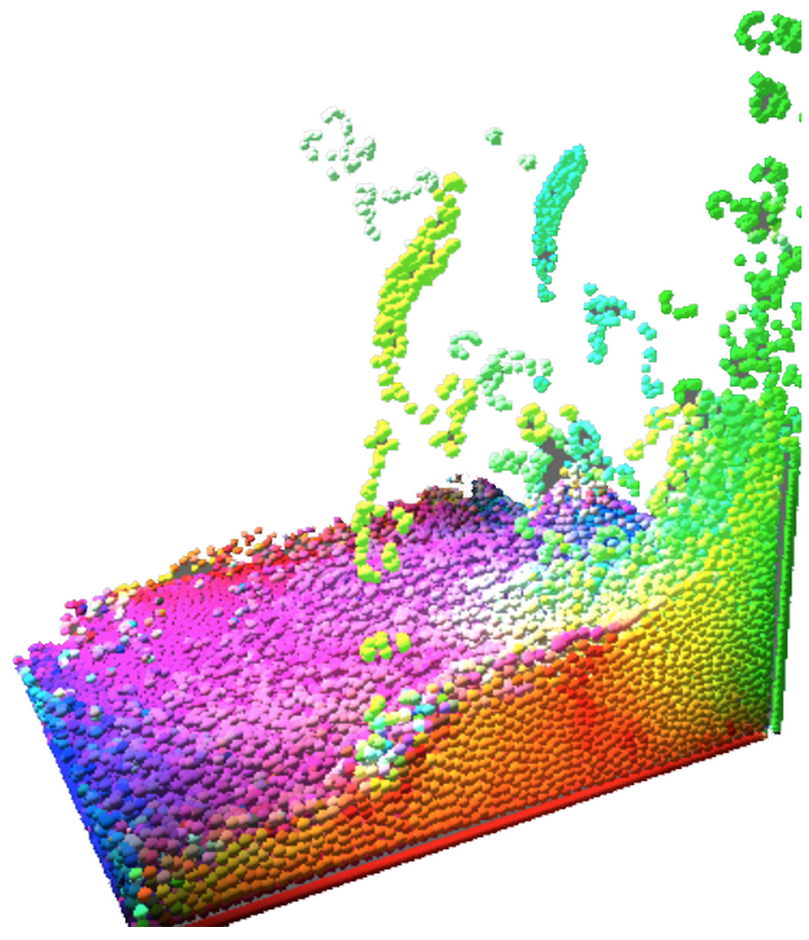
Particle Fluid Simulation
Alex Miller and Noah Lyons – CIS 700/003 Spring 2014
Notes:
Video: http://vimeo.com/103072321
Slides: https://docs.google.com/presentation/d/1JbPvI1NS7ExcDAGiAbU6cjhfUQzfhptHNNa48eK97oo/edit#slide=id.p
Sec3 engine: http://www.noahbenjaminlyons.com/sec3/
Demo: http://alexmiller12.github.io/WebGL-Fluids/
SPH using density and pressure.
Alex and Noah also implemented:
GPU-accelerated particle system with self-shadowing and order-independent transparency
Cascaded shadow maps with percentage closer filtering
Depth of field with smoothed foreground edges and variable width blur
Forward and deferred shading

Slide 29
Tools

Slide 30
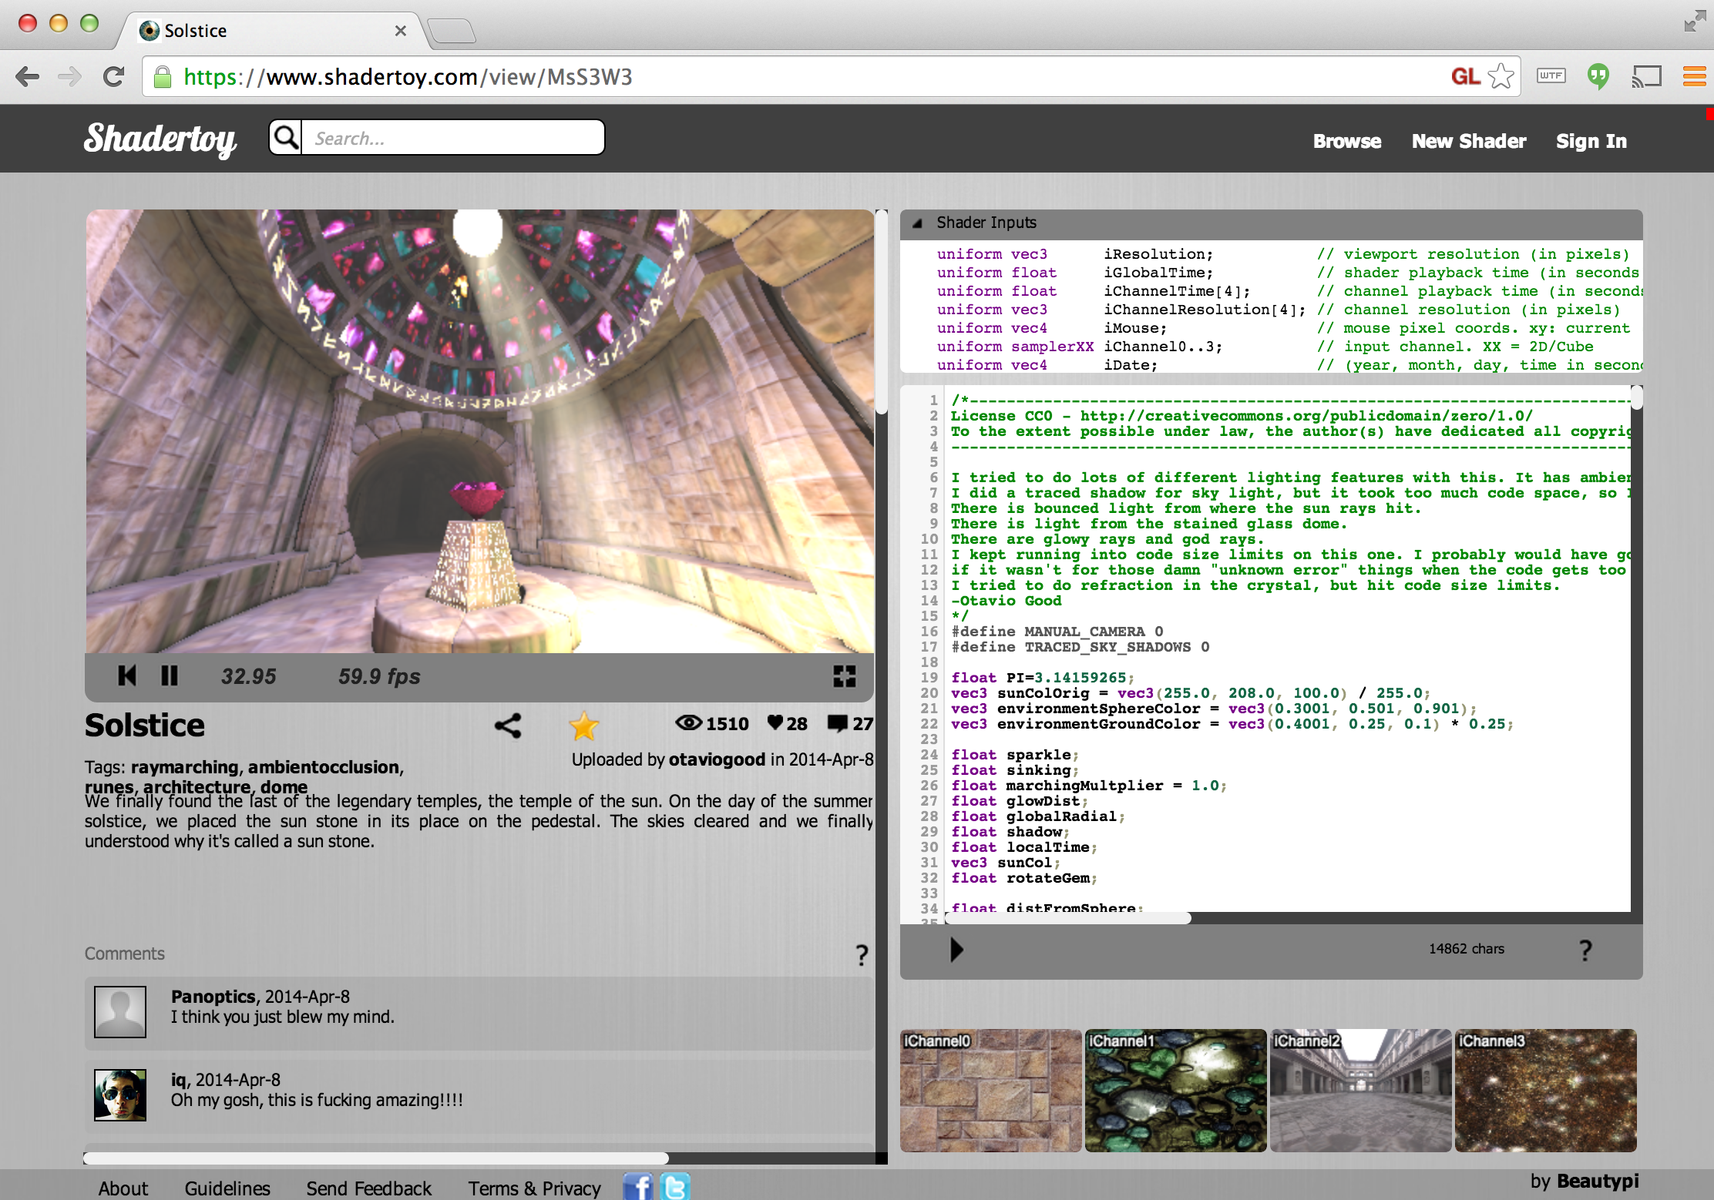
Online Shader Editors
Notes:
Shadertoy
https://www.shadertoy.com
Great for class hackathons
“Hackathons in the classroom” by Patrick Cozzi. 2012. http://blog.virtualglobebook.com/2012/12/hackathons-in-classroom.html
Great for ray marching distance functions
“Rendering Worlds with Two Triangles with raytracing on the GPU in 4096 bytes” by Iñigo Quilez. 2008. http://www.iquilezles.org/www/material/nvscene2008/rwwtt.pdf
Slides 23-29 in particular
“Modeling with distance functions” by Iñigo Quilez. 2008. http://iquilezles.org/www/articles/distfunctions/distfunctions.htm
GLSL Sandbox
http://glsl.heroku.com/
Older than Shadertoy but allows reading the previous frame’s backbuffer, for example, for implementing cellular automata.

Slide 31
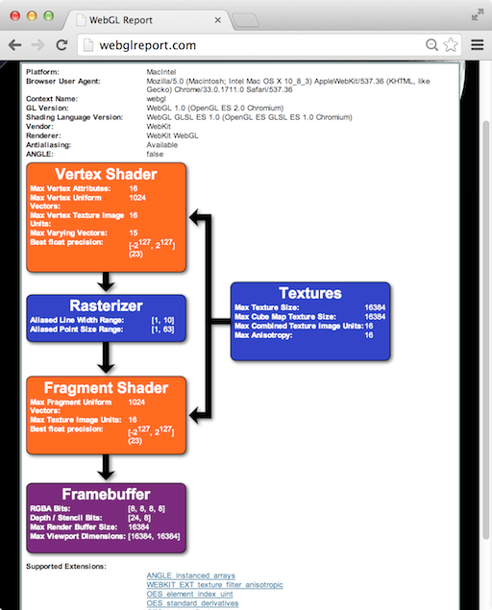
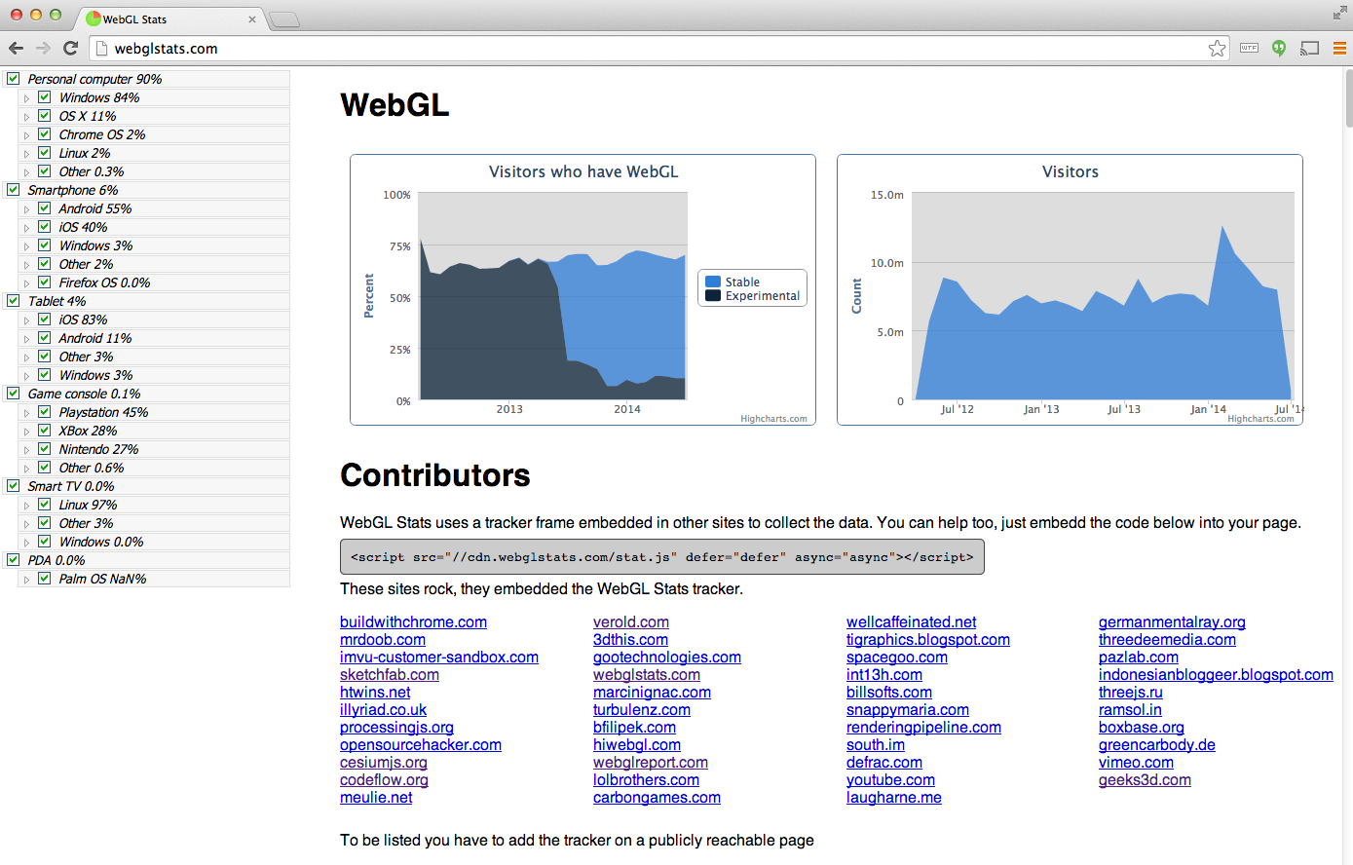
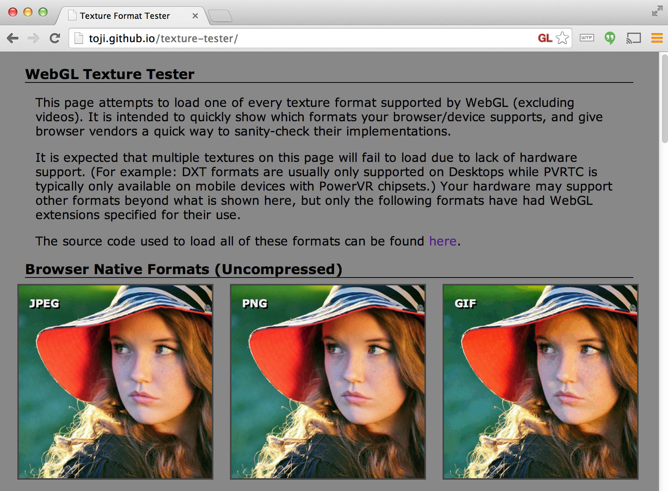
System Capability Tools
Notes:
WebGL Report
See system-dependent values and extensions
App: http://webglreport.com/
WebGL Stats
App: http://webglstats.com/
Info: http://codeflow.org/entries/2014/feb/04/webgl-stats-version-2/
WebGL Texture Tester
See what texture formats a system supports
App: http://toji.github.io/texture-tester/
See “WebGL Debugging and Profiling Tools” by Patrick Cozzi. 2013. http://www.realtimerendering.com/blog/webgl-debugging-and-profiling-tools/

Slide 32
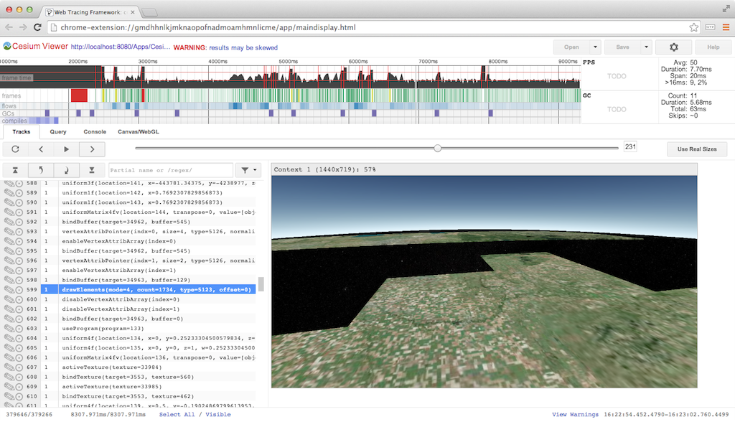
Web Tracing Framework
Notes:
Web Tracing Framework (WTF)
http://google.github.io/tracing-framework/
By Google
Similar to Canvas debuggers plus see the timing of each frame in detail
Show common CPU bottlenecks
GC (browser)
Shader compile/link (driver)
Texture/buffer upload (driver)
readPixels (stall)
WebGL Inspector
http://benvanik.github.io/WebGL-Inspector/
Older tool similar to Canvas debuggers and WTF

Slide 33
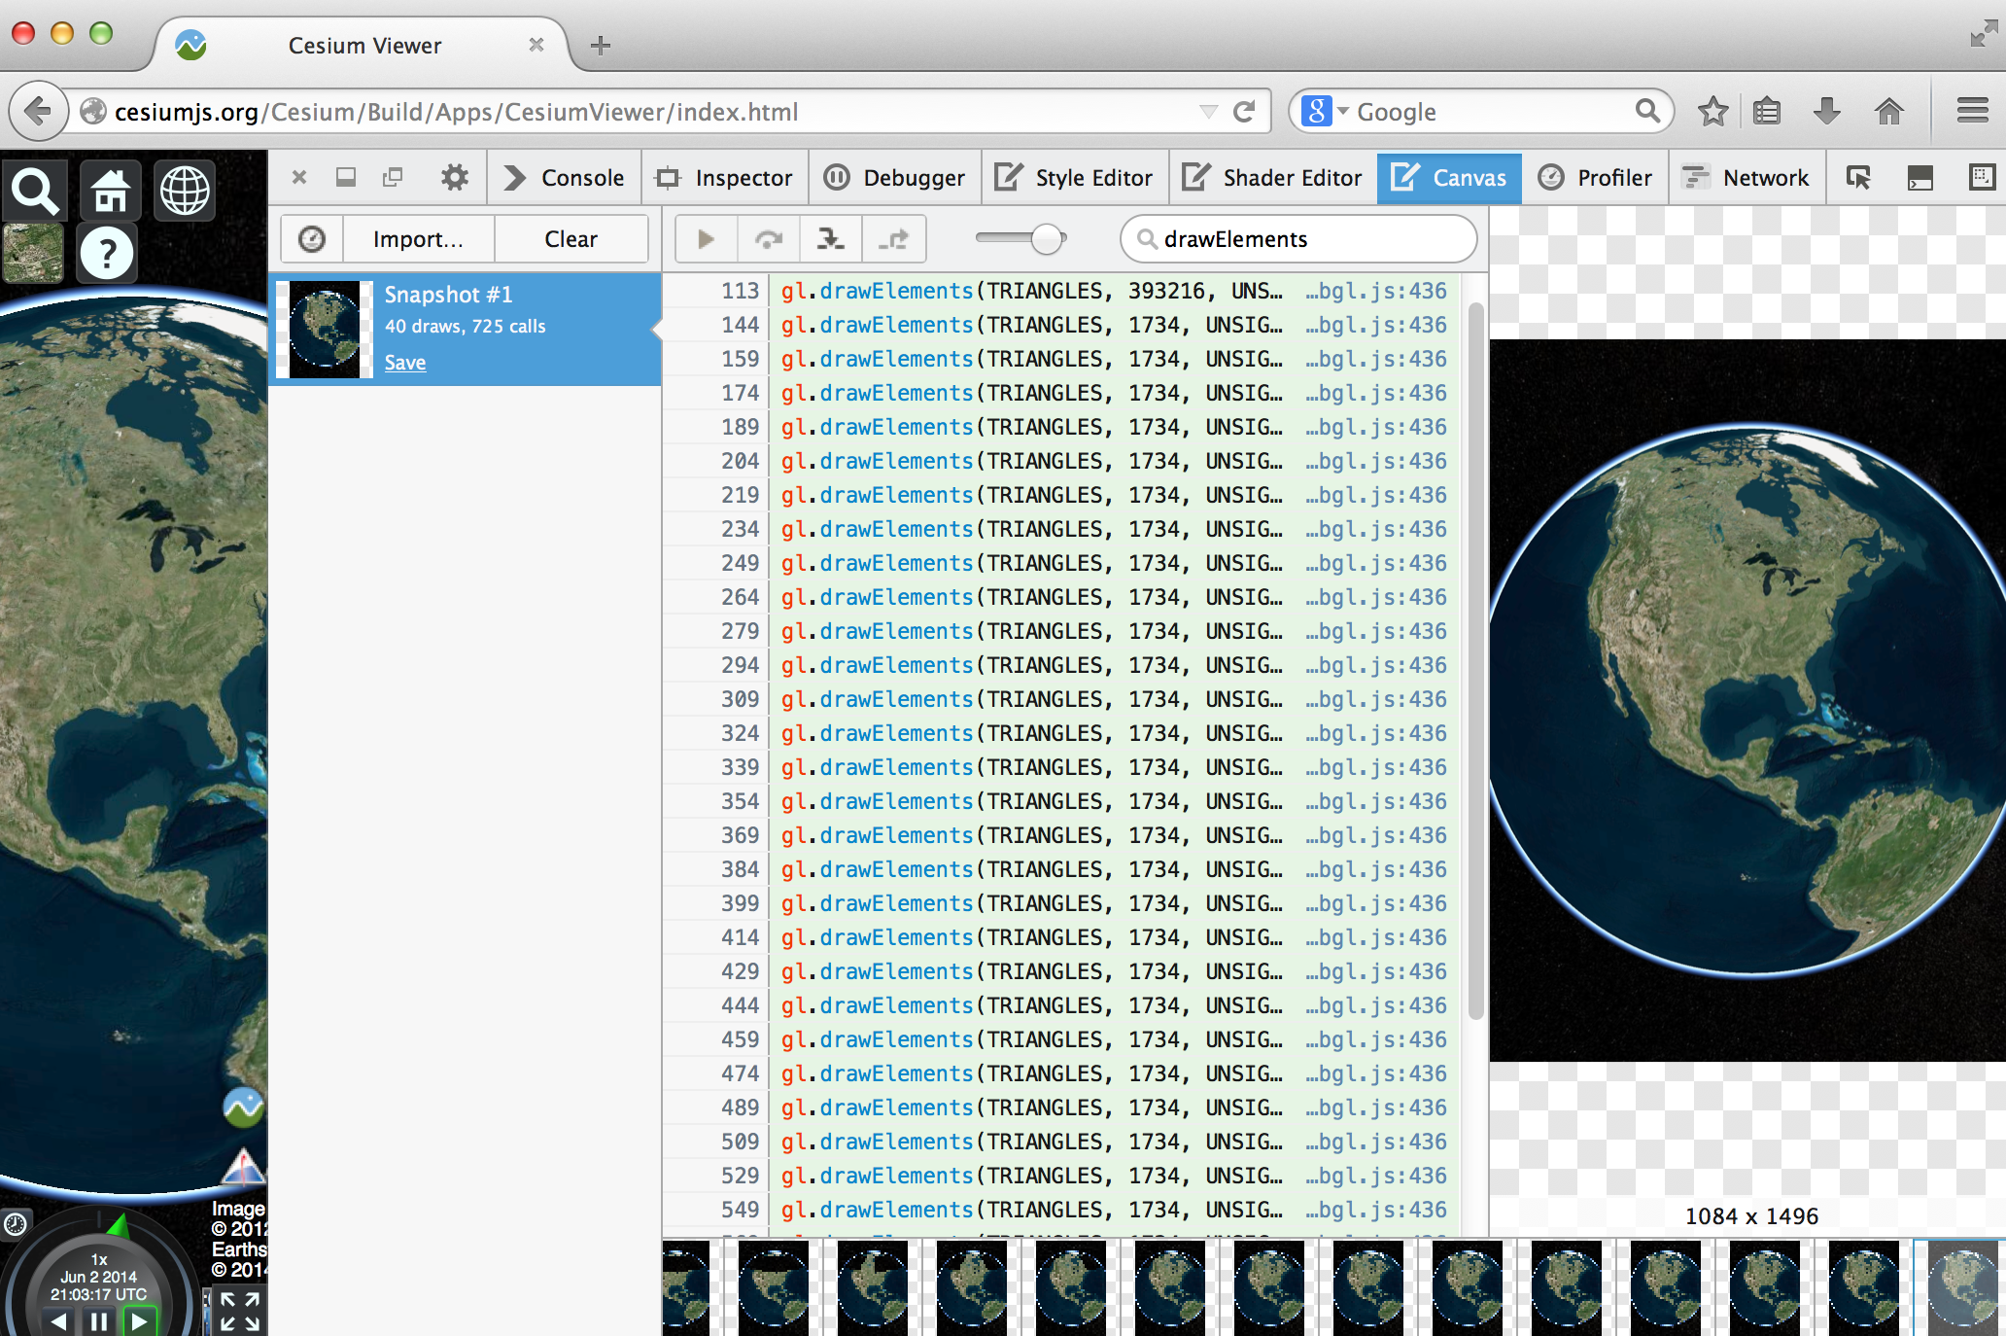
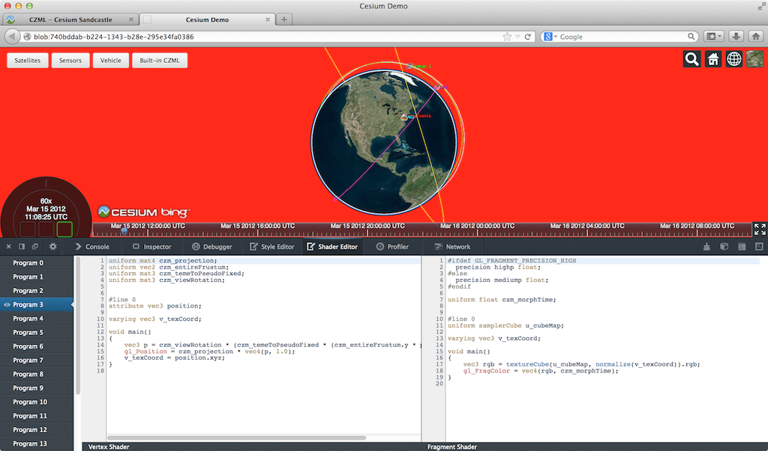
WebGL Tools - Firefox
Notes:
WebGL Shader Editor
See all loaded shaders
See what part of the scene is affected by a shader
Tweak shaders on the fly
Article: https://hacks.mozilla.org/2013/11/live-editing-webgl-shaders-with-firefox-developer-tools/
Canvas Debugger
Step through a frame. Filter calls. See the scene build draw call by draw call.
Article: https://hacks.mozilla.org/2014/03/introducing-the-canvas-debugger-in-firefox-developer-tools/

Slide 34
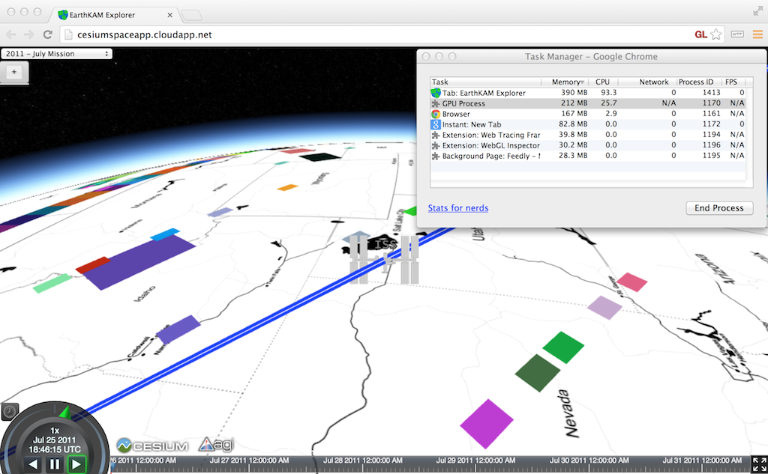
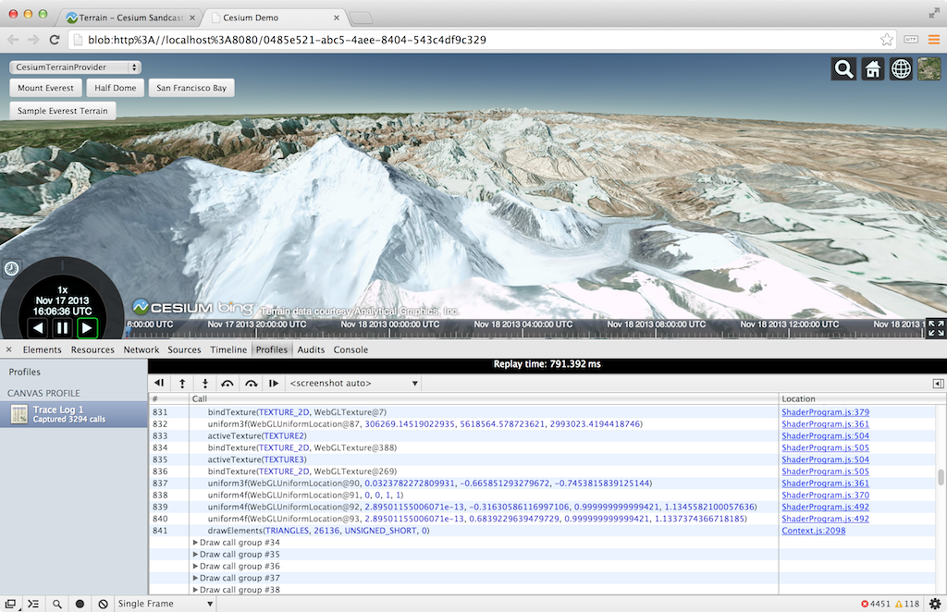
WebGL Tools - Chrome
Notes:
Canvas Inspector
Similar to Firefox Canvas Debugger. Integrates nicely with Chrome debugger
Article: http://www.html5rocks.com/en/tutorials/canvas/inspection/
Chrome Task Manager
Useful for quick and dirty memory usage
in the Window menu

Slide 35
All WebGL Sessions at SIGGRAPH
http://cesiumjs.org/blog.html

Slide 36
Contact Info
Slides: https://t.co/xuy7V2Q06m
Patrick Cozzi
Analytical Graphics, Inc.
University of Pennsylvania
@pjcozzi
pjcozzi@siggraph.org
www.seas.upenn.edu/~pcozzi/
Ed Angel
University of New Mexico
angel@cs.unm.edu
www.cs.unm.edu/~angel/

Slide 37
Bonus: WebGL on Mobile From Olli Etuaho, NVIDIA

Slide 38
Qualitative differences between mobile and desktop
1. highp shaders not supported everywhere - and testing lowp and mediump shaders requires specific hardware, since on desktop lowp and mediump evaluate as highp as well.
1.1. Example gotcha from a real app: accessing cube map with a non-normalized vector can cause severe distortion when the shader is running in low precision, while it looks fine on desktop where variables specified as lowp are actually evaluated at higher precision.
2. Extension support varies more: most importantly s3tc compressed textures, anisotropic filtering and OES_texture_float, ANGLE_instanced_arrays are much less widely supported (webglstats.com). Using floating-point textures as framebuffer attachments is not supported on any GLES2 device.
2.1. Rendering to RGB floating-point textures not supported on GLES3 devices either, only RGBA if the driver has the right extensions. This is due to limitations in the GLES3 EXT_color_buffer_float spec.

Slide 39
Qualitative differences between mobile and desktop
3. Context loss is more likely: power events, robustness limits easier to hit.
4. Mobile devices are typically HighDPI, so 1:1 pixel rendering is harder to achieve. http://www.khronos.org/webgl/wiki/HandlingHighDPI https://www.khronos.org/webgl/public-mailing-list/archives/1311/
5. Various limitations exposed by getParameter. These apply to some desktop platforms as well, but limitations are much more common on mobile: Texture access from vertex shaders may not be supported at all. Multisampling may not be supported. Depth buffer precision can be lower (16-bit is much more common on old mobile SOCs), and shader variable count limits are tighter.
6. GenerateMipmap for any 32-bit float textures might not be supported, even if OES_texture_float_linear is supported. (On IMG GPUs, see https://github.com/KhronosGroup/WebGL/issues/408 ). GenerateMipmap is not supported for RGB float textures on any ES3 device (see ES3 GenerateMipmap spec).

Slide 40
Performance differences between mobile and desktop
1. Memory bandwidth is limited, which will cause one of two things:
1.1. On chunker architectures, which cache a part of the framebuffer in GPU memory, state changes like switching framebuffers can be especially expensive. Avoid state changes.
1.2. On modern, desktop-like SOCs like Tegra K1, framebuffer access is more time-consuming. However, ways to mitigate:
1.2.1. Avoid overdraw.
1.2.2. Do work in shaders instead of issuing multiple draw calls where possible - shaders have plenty of processing power! This trend is only expected to grow stronger in the future.
2. Lowp and mediump shader math might be faster, lower-power than highp
3. Memory capacity can be limited compared to desktop.
Notes:
The main issue is choosing what you want to target: The new GLES3 generation of mobile devices are relatively well equipped to handle WebGL. NVIDIA is especially committed to delivering a good mobile WebGL implementation, and on SOCs starting from Tegra K1, WebGL should work like on desktop. Often the only thing to do to make a port from desktop to work on many more devices is to make sure touch input is supported. Widely supporting different older mobile hardware is a bigger ordeal.

